Slide 1
A.I and machine learning
Day 1
Made by: Ahmed Saeed

Slide 2
01
Artificial intelligence

Slide 3
Artificial intelligence
Artificial Intelligence refers to the development of computer systems that can perform tasks that typically require human intelligence. These tasks include problem-solving, learning, perception, understanding natural language, and even decision-making.
AI can be categorized into two main types:
Narrow or Weak AI
This type of AI is designed and trained for a particular task. Examples include voice assistants, image recognition, and chatbots.
General or Strong AI
This is a more advanced form of AI that possesses the ability to understand, learn, and apply knowledge across diverse domains, like human intelligence.

Slide 4
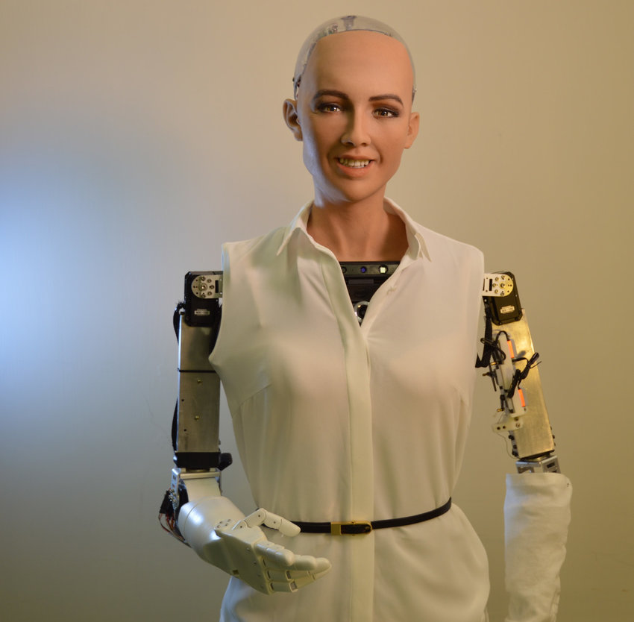
Artificial intelligence
Weak A.I examples
Siri, google assistant , amazon Alexa, Facial recognition , text to speech or speech to text , Netflix recommendations, simple chat bots
Strong AI examples
Human-like Robots, Self-driving cars, AI-generated art, novel writing ,
Advanced Chatbots , AI systems capable of diagnosing various medical conditions.
It's important to note Strong AI remains a theoretical concept, and we have not achieved a system with the broad cognitive abilities and adaptability of the human mind.
Sophia robot by Hanson robotics

Slide 5
02
Machine learning

Slide 6
Machine learning
Machine Learning is a subset of AI that focuses on enabling computers to learn from data and improve their performance over time without being explicitly programmed. ML algorithms are designed to identify patterns, make predictions, and optimize decisions based on the given data.
Key components of ML include:
Supervised Learning
The algorithm is trained on a labeled dataset, where it learns to map input data to the correct output.
Unsupervised Learning
The algorithm works with unlabeled data, identifying patterns and relationships without predefined outputs.
Reinforcement Learning
Agents learn to make decisions by interacting with an environment, receiving feedback in the form of rewards or penalties.

Slide 7
03
Python role in A.I ML

Slide 8
Python
Python has become the language of choice for AI and ML practitioners due to its simplicity, readability, and a vast ecosystem of libraries and frameworks. Some popular
Python libraries for AI/ML include:
NumPy and Pandas:
For data manipulation and analysis.
Scikit-learn:
A comprehensive library for machine learning algorithms.
TensorFlow and PyTorch:
Deep learning frameworks for building neural networks.
NLTK (Natural Language Toolkit):
For processing human language data.
Matplotlib and Seaborn:
Visualization libraries to present data insights.

Slide 9
Our goals
Linear regression
Natural language chatbot
linear regression is a machine learning algorithm that falls under the umbrella of supervised learning. It will be explained more in depth in later parts
A Natural Language Processing (NLP) bot interprets and responds to human language. It's adept at understanding and generating text, enhancing interactive experiences across various applications.

Slide 10
03
Linear Regression

Slide 11
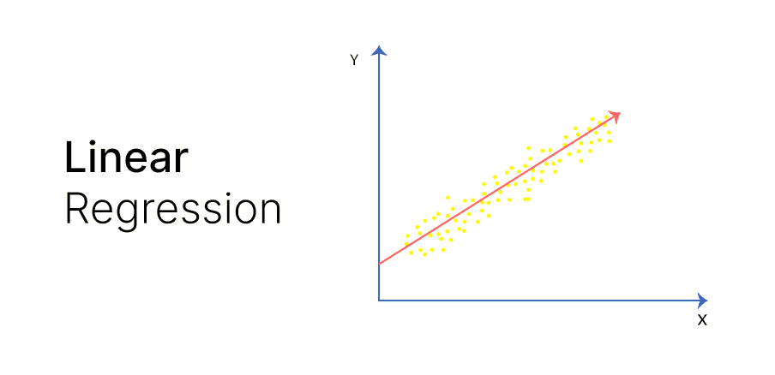
Linear Regression
Linear regression is a fundamental statistical method and a supervised machine learning algorithm used for predictive modeling and understanding the relationship between a dependent variable and one or more independent variables. The core idea behind linear regression is to establish a linear equation that best represents the relationship between the variables.
In a simple linear regression, there is one dependent variable (the target) and one independent variable (the predictor). The goal is to find the equation of a straight line (linear regression line) that minimizes the sum of the squared differences between the observed and predicted values.
This line is defined by the equation: y= mx + b

Slide 12
Linear Regression
Linear regression can be used to predict a student's future academic performance based on variables such as study hours, previous grades, and attendance. This helps identify factors influencing academic success.
And with that said let’s start coding

Slide 13
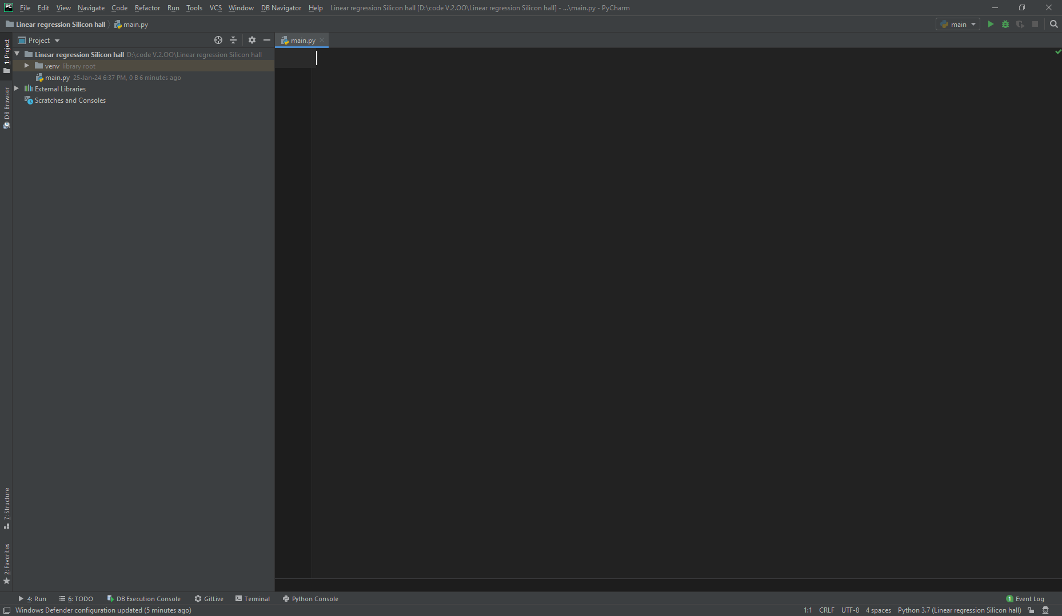

What do we need to start?
PyCharm
Or any other IDE you are comfortable with using.
Like VSC

Slide 14
04
Libraries needed

Slide 15

TensorFlow
TensorFlow is an open-source machine learning library developed by Google. It facilitates the creation and deployment of machine learning models, especially neural networks, by providing a comprehensive framework for building, training, and deploying artificial intelligence applications. TensorFlow's flexibility and scalability make it widely used in various fields, from research to production-level applications.
Types of algorithms supported by TensorFlow :
Logistic Regression
Neural Networks
Linear Regression
Reinforcement Learning

Slide 16


NumPy and pandas
NumPy is a powerful numerical computing library for Python. It provides support for large, multi-dimensional arrays and matrices, along with a collection of high-level mathematical functions to operate on these arrays. NumPy is essential for scientific computing tasks, offering efficient data manipulation, linear algebra operations, statistical analysis, and integration with other data science tools.
Pandas is a data manipulation and analysis library for Python. It introduces two primary data structures, Series and DataFrame, which simplify the handling and manipulation of structured data. Pandas excels in tasks like data cleaning, transformation, and exploration, making it a go-to tool for data scientists and analysts. It seamlessly integrates with other Python libraries and tools, providing a versatile environment for data manipulation and analysis.

Slide 17
Libraries
So, to save time lets download all the libraires needed for the day in one command and just run the following command
pip install tensorflow scikit-learn pandas

Slide 18
05
Datasets

Slide 19
Why we need datasets?
Datasets are crucial for training AI because they provide the raw material that algorithms use to learn patterns, relationships, and features. Without diverse and representative datasets, AI models would lack the necessary information to make accurate predictions or classifications. Training on well-curated datasets allows AI systems to generalize knowledge, adapt to various scenarios, and improve their performance. Datasets serve as the foundation for teaching AI algorithms to recognize patterns, understand contexts, and make informed decisions, ultimately enhancing their ability to handle real-world tasks.

Slide 20


Where to do datasets?
For this course all datasets used will be provided but for future projects you can get all types of datasets from http://archive.ics.uci.edu
For the student info dataset, it can be installed from http://archive.ics.uci.edu/dataset/320/student+performance
Archive of datasets
Student dataset

Slide 21
06
Pandas viewing datasets

Slide 22
Pandas
import pandas as pd data = pd.read_csv("student-mat.csv", sep=";", ) # chose the path the file relative to your system data = data[["G1", "G2", "G3", "studytime", "failures", "absences"]] # pick the columns or features u think matter the most # feel free to experiment with your own features to get a better accuracy print(data.head()) print(data.drop([“G3”], axis=1)) # to remove columns or features

Slide 23
Pandas
Terminal output:
G1 G2 G3 studytime failures absences 0 5 6 6 2 0 6 1 5 5 6 2 0 4 2 7 8 10 2 3 10 3 15 14 15 3 0 2 4 6 10 10 2 0 4
G1 G2 studytime failures absences 0 5 6 2 0 6 1 5 6 2 0 4 2 7 10 2 3 10 3 15 15 3 0 2 4 6 10 2 0 4
Removed the G3 column

Slide 24
07
Linear Model: linear regression

Slide 25
Linear regression.
predict = "G3" # the variable or feature we are gonna try to predict x = np.array(data.drop([predict], axis=1)) # 1 is to drop the whole column y = np.array(data[predict]) xtrain, xtest, ytrain, ytest = sklearn.model_selection.train_test_split(x,y,test_size=0.1) linear = linear_model.LinearRegression()#create the model linear.fit(xtrain, ytrain)# train the model on the data acc = linear.score(xtest,ytest) # test the model on the data print(acc) print("Co: ", linear.coef_) print("Intercept: ", linear.intercept_)

Slide 26
Linear regression.
0.766472375558413 Co: [ 0.12879793 0.98605137 -0.06470746 -0.28793874 0.03163438] Intercept: -1.4649963687703753

Slide 27
Linear regression.
To see the predictions one by one.
predicts = linear.predict(xtest) for x in range(len(predicts)): print(predicts[x], xtest[x],ytest[x])

Slide 28
08
Saving the model

Slide 29
Saving the model
To save the models with the highest accuracy, we can use the pickle library.
import pickle with open(“filename.pickle”,”wb”) as file: pickle.dump(object, file)
To Save the models we can dump it the file using this code.
import pickle file = open(“filename.pickle”, “rb”) Linear = pickle.load(file)
To load the saved models, we can use the following snippet

Slide 30
Saving the model
We can use the mentioned method to train a model thousands of times and save the best one using a simple for loop
best = 0 for i in range(25):#change the number to the number of runs u want xtrain, xtest, ytrain, ytest = sklearn.model_selection.train_test_split(x,y,test_size=0.1) linear = linear_model.LinearRegression() linear.fit(xtrain, ytrain) linear = pickle.load(open("studentmodel.pickle", "rb")) acc = linear.score(xtest,ytest) print(acc) if acc>best: best = acc with open("studentmodel.pickle", "wb") as f: pickle.dump(linear, f)

Slide 31
08
Plotting the data

Slide 32
Using matplotlib
To plot our data on a graph we can use matplotlib to do so
style.use(“ggplot”) # to set a decent style plt.scatter(data[“x-axis”],data[“y-axis”]) plt.xlabel(“x-label”) plt.ylabel(“y-label”) plt.show()#to show the graph
To Save the models we can dump it the file using this code.
#don’t forget to install the library using pip install matplotlib
To load the saved models we can use the following snippet

Slide 33
Using matplotlib
To plot our data on a graph we can use matplotlib to do so
# Drawing and plotting model plot = "failures" plt.scatter(data[plot], data["G3"]) plt.xlabel(plot) plt.ylabel("Final Grade") plt.show()

Slide 34
09
Quiz

